Slide 1

Object Oriented Programming
Structural Design Patterns: Facade
IT560
Sourish Dasgupta
Assistant Professor, DA-IICT, Gandhinagar
https://daiict.ac.in/faculty/sourish-dasgupta

Slide 2
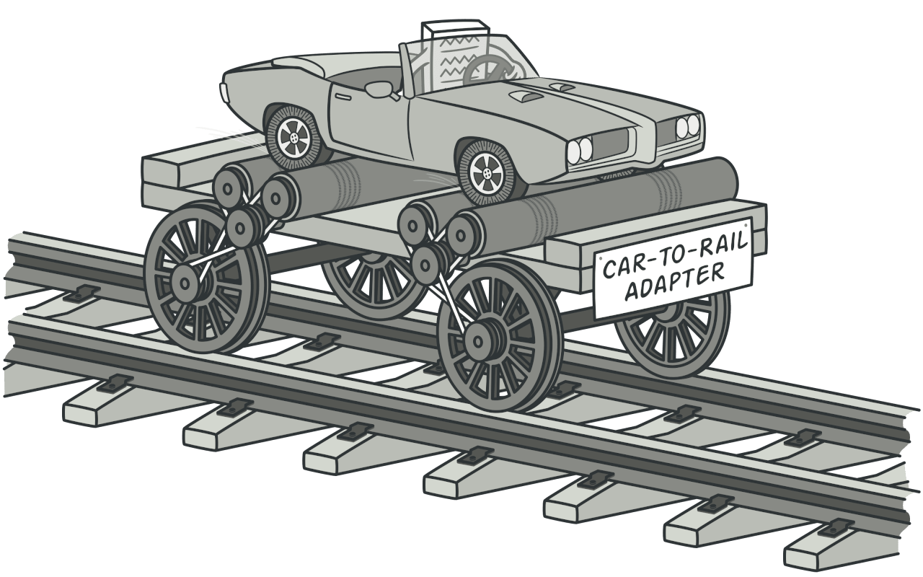
Adapter Design Pattern : Compatibility with single interface
Car vs. Rail track
Do not help in having a unified interface to a complex (multi) sub-system (with multiple operations)
Do not help in coordination within the complex sub-system
Do not help decouple client with a complex sub-system
IT560: Structural Design Patterns: Facade
Sourish Dasgupta

Slide 3
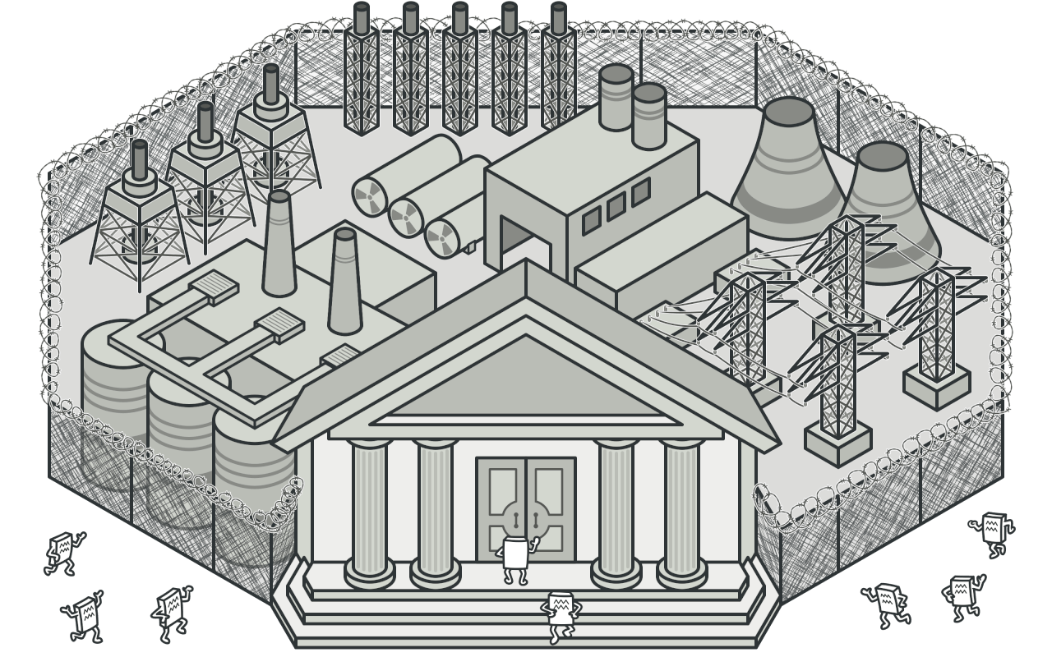
What is a Facade?
Hidden!!
Facade!!
Client Objects
IT560: Structural Design Patterns: Facade
Sourish Dasgupta

Slide 4
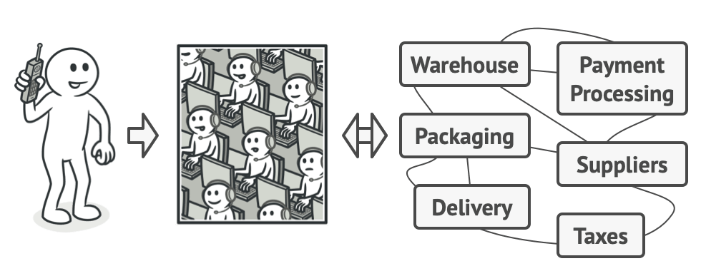
A concrete example: Ordering over the phone
Facade!!
Hidden!!
Client Object
IT560: Structural Design Patterns: Facade
Sourish Dasgupta

Slide 5

Key Takeaways: Facade
Aspect | Description
Purpose | Simplifies interaction with complex subsystems by providing a unified interface.
Benefits | Decouples clients from subsystem details, hides complexity, and makes the system easier to use.
Usage Example | An order processing system that integrates inventory checks, payment processing, and shipping.
Client Interaction | The client calls a single method (e.g., process_order()) on the facade, instead of multiple subsystem calls.
IT560: Structural Design Patterns: Facade
Sourish Dasgupta

Slide 6
Takeaways: Facade (vs. Adapter)
Feature | Differences
Subsystem Coordination | Orchestrates interactions between multiple classes or subsystems Vs. Only wraps a single interface
Unified High-Level Abstraction | Comprehensive, simplified interface to a complex system, hiding the internal complexity. Vs. Does not consolidate multiple operations into one cohesive interface.
Decoupling from Complex Subsystems | Decouples the client from an entire set of interrelated subsystems. Vs. Solely focused on making one incompatible interface work with another.
IT560: Structural Design Patterns: Facade
Sourish Dasgupta

Slide 7
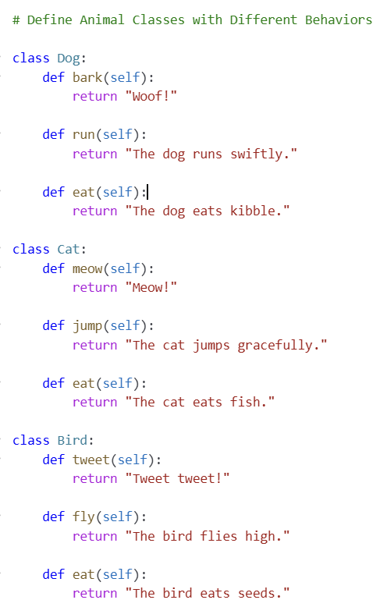
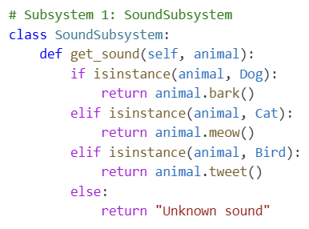
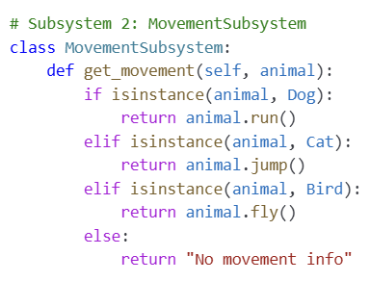
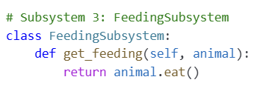
Toy example of creating sub-systems out of similar classes
IT560: Structural Design Patterns: Facade
Sourish Dasgupta

Slide 8
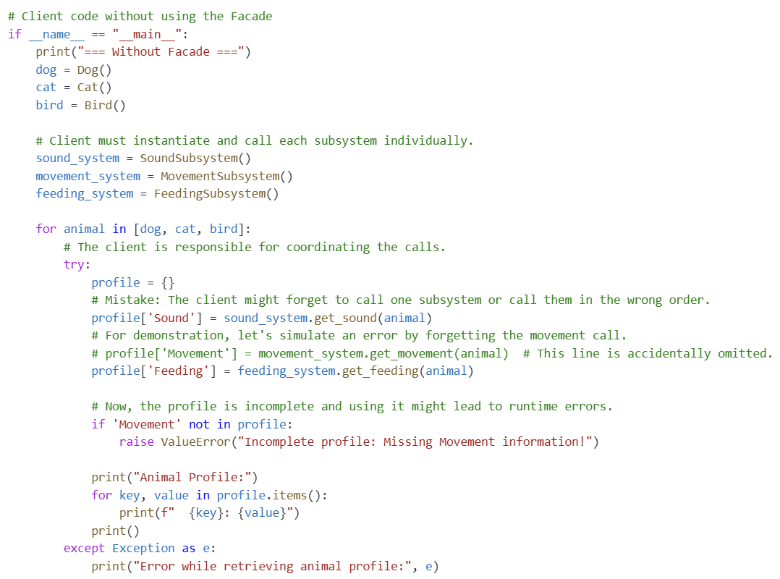
Don’t want Facade? Going to give client a lot of headache!!
IT560: Structural Design Patterns: Facade
Sourish Dasgupta

Slide 9
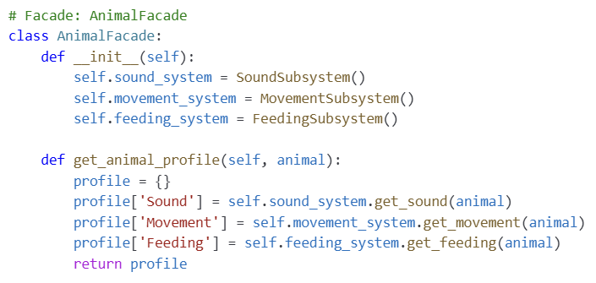
Facade abstracts the sub-systems!
IT560: Structural Design Patterns: Facade
Sourish Dasgupta

Slide 10
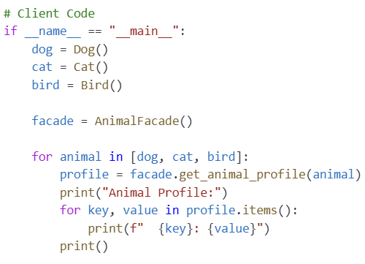
Facade abstracts the sub-systems: Client has no headache!
Trivia: Extracts the tuple from dictionary
IT560: Structural Design Patterns: Facade
Sourish Dasgupta

Slide 11
Can we do better?
IT560: Structural Design Patterns: Facade
Sourish Dasgupta

Slide 12
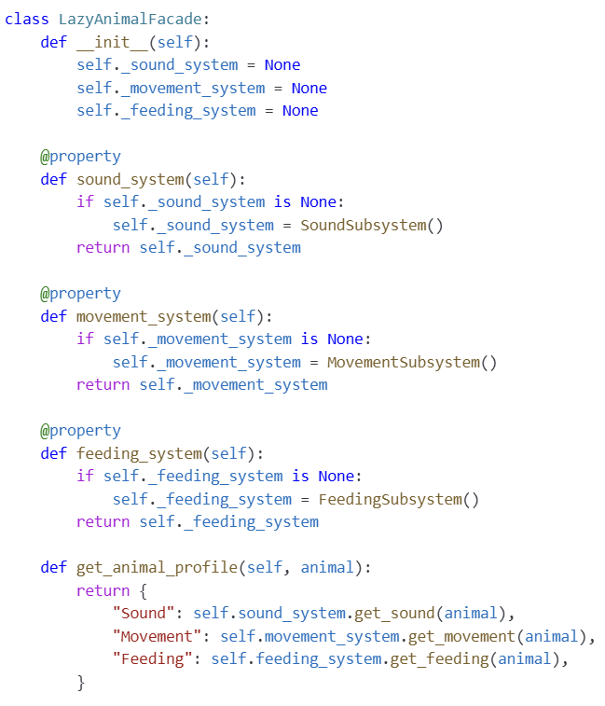
FP-style optimization
Keep it uninitialized
Trivia: Decorator enforcing lazy (i.e., dynamic) calling → call-when-needed; READ-ONLY
IT560: Structural Design Patterns: Facade
Sourish Dasgupta

Slide 13
Is creating facade always good?
IT560: Structural Design Patterns: Facade
Sourish Dasgupta

Slide 14
Cautionary comments
Aspect | Advantages | Disadvantages
Complexity Handling | Reduces complexity by hiding subsystem details. | Can lead to unnecessary abstraction if overused.
Dependency Management | Decouples client from subsystem changes. | Clients need update if Facade needs update → an adapter to the facade??
Performance | Makes API calls easier and more structured. | Can introduce slight overhead when forwarding requests.
IT560: Structural Design Patterns: Facade
Sourish Dasgupta

